Slide 1
Proposal: Boolean Gene Implication Network Construction from single-cell RNA-seq data
Brian Arand

Slide 2
Outline
Motivation
Proposal
Aim 1| Develop a workflow to construct directed gene implication networks conducive to intuitive analysis of gene expression at the cellular level using single-cell RNA-seq data.
Aim 2| Visualize the constructed directed gene implication network in an intuitive hypothesis generation tool allowing biomedical researchers to develop new hypothesis on gene relationships.
Datasets
Validation
Questions

Slide 3
Motivation
Gene Regulatory Network Approximation
A convoluted space
Transcription Factors & co-factors
Promoters and Repressors
Time latency effect
Molecular degradation
Mixture of sub-populations (some which can be rare)
Limitations of bulk transcriptomics
Averaging effects of cellular information at tissue resolution
Simpson’s Paradox -> divide and conquer strategy

Slide 4
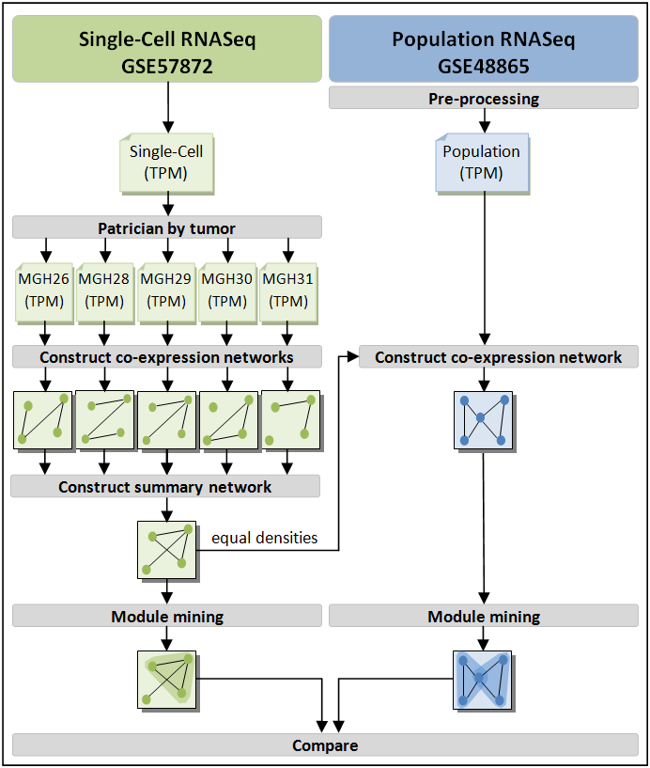

Slide 8
Implication Networks Alternatives
Information Theory:
Dependency metrics: PCC, Spearman, MI, etc…
Boolean/Fuzzy Logic:
Differential Equations:
Requires temporal ordering
Bayesian:
Hypothesis model selection difficult in practice

Slide 9
Aim 1
To construct directed Boolean gene implication networks conducive to intuitive analysis of gene expression at the cellular level.
Methodology:
DREMI re-sampling
Discretization/Fuzzification
Implication Classification
Network Construction

Slide 10
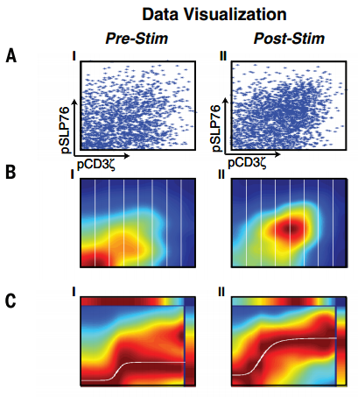
Aim 1: DREMI Re-sampling
No clear statistical dependency between proteins (known relationship in literature)
Why?
Majority of cells express in a narrow range.
The joint density is dominated by small window.
Hides the functional response of Y across the entire dynamic range of X.
Consensus Y response is easier to detect in conditional space.

Slide 11
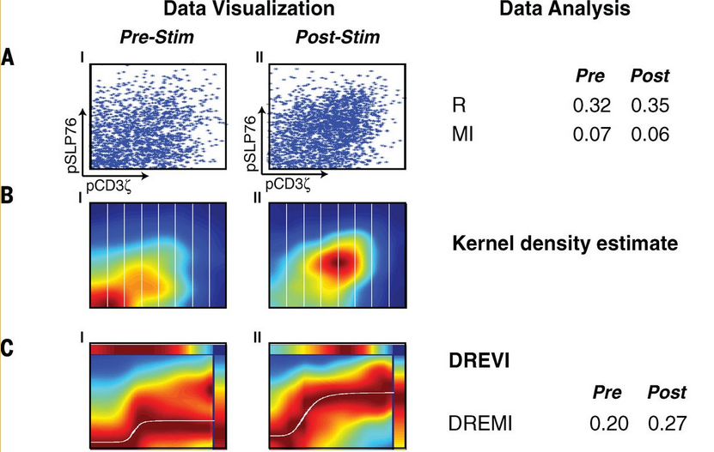
Aim 1: DREMI Re-sampling

Slide 12
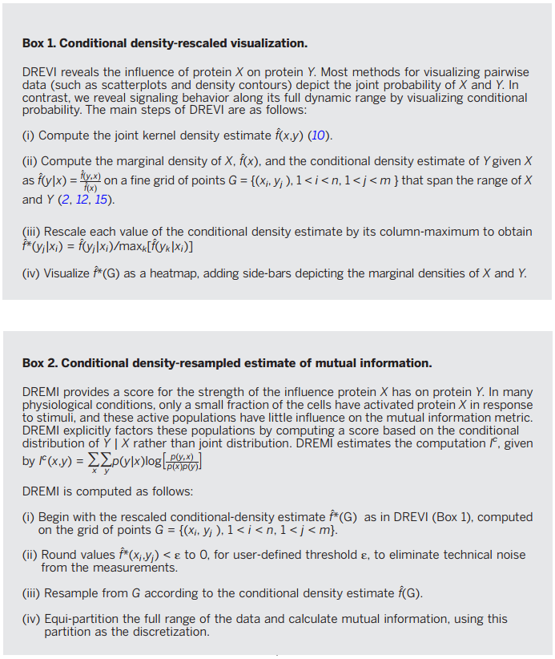
Aim 1: DREMI Re-sampling

Slide 13
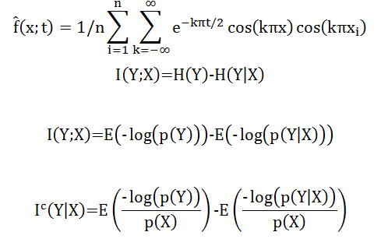
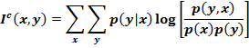
Aim 1: DREMI Re-sampling

Slide 14
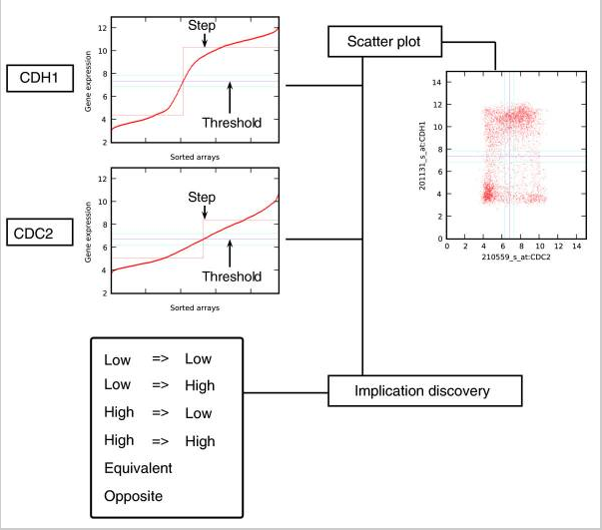
Aim 1: Discretization/Fuzzification
Sahoo, Debashis, et al. "Boolean implication networks derived from large scale, whole genome microarray datasets." Genome Biol 9.10 (2008): R157.

Slide 15
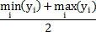
Aim 1: Discretization/Fuzzification
May want to use Y high-low threshold:
Rationale:
DREMI removes outliers and prevents the inclusion of new outliers upon re-sampling.
There is a claim then that all data points in the re-sampling represent true signal.
We are particularly interested in preserving the relative Boolean encoding of points in the presence of rare cell sub-types.

Slide 16
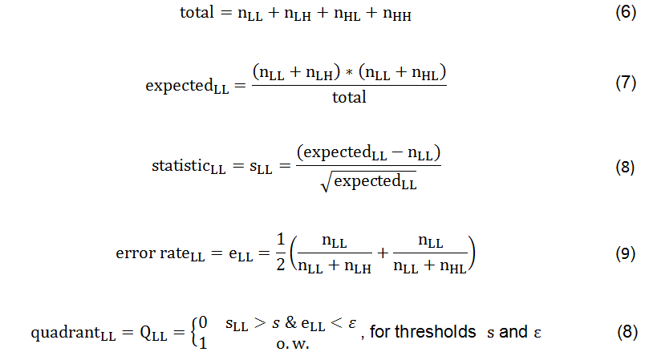
Aim 1: Discretization/Fuzzification
Sahoo, Debashis, et al. "Boolean implication networks derived from large scale, whole genome microarray datasets." Genome Biol 9.10 (2008): R157.

Slide 17
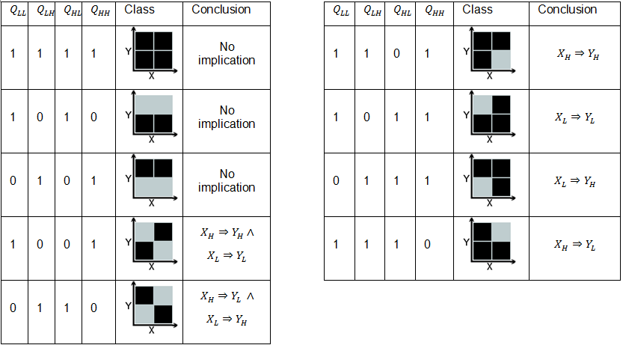
Aim 1: Implication Classes

Slide 18
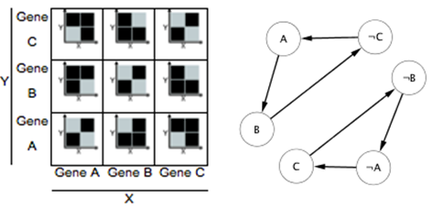
Aim 1: Boolean Implication Network

Slide 19
AIM 1: Obstacles
Drop-out events
Sample size must be sufficient to estimate conditional probability.

Slide 20
Aim 3
Visualize for hypothesis generation tool while providing an array of organizational and information tools to aid investigators’ navigation.
Components
Condensed visual encoding
Interactive visualization R package

Slide 21
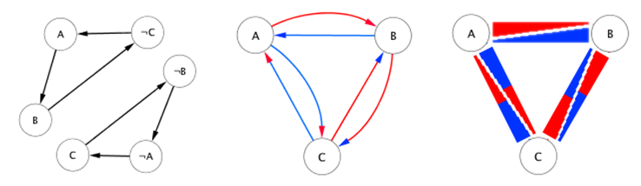
Aim 3: Glyph Edge Visual Encoding

Slide 22
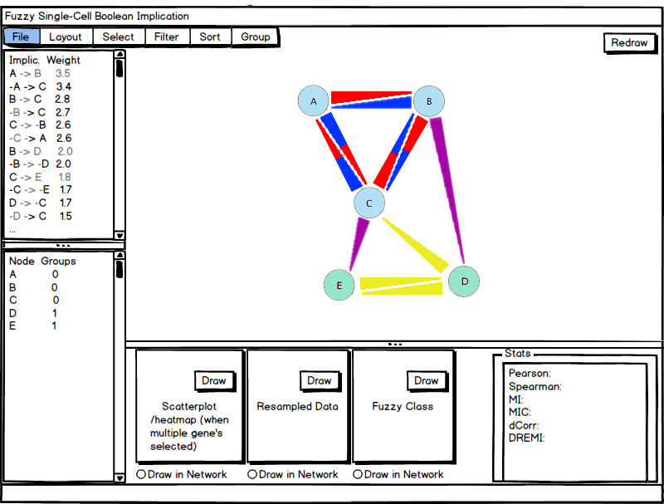
Aim 3: Hypothesis Generation Application

Slide 23
AIM 1 Extended: Pseudotemporal order
To broaden the scope of the gene implication network construction method to analyze the changes in gene expression implication through a dynamic biological process.
Methodology:
Pseudotemporal ordering (Monocle)
Clustering and ‘agreement’
Construct Boolean implication network per cluster

Slide 24
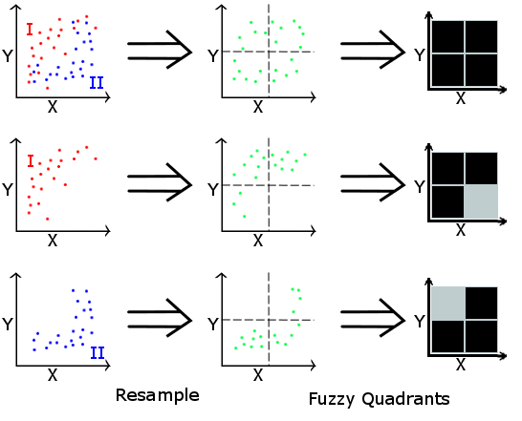
AIM 1 Extended: Effects of Convolved Signals

Slide 25
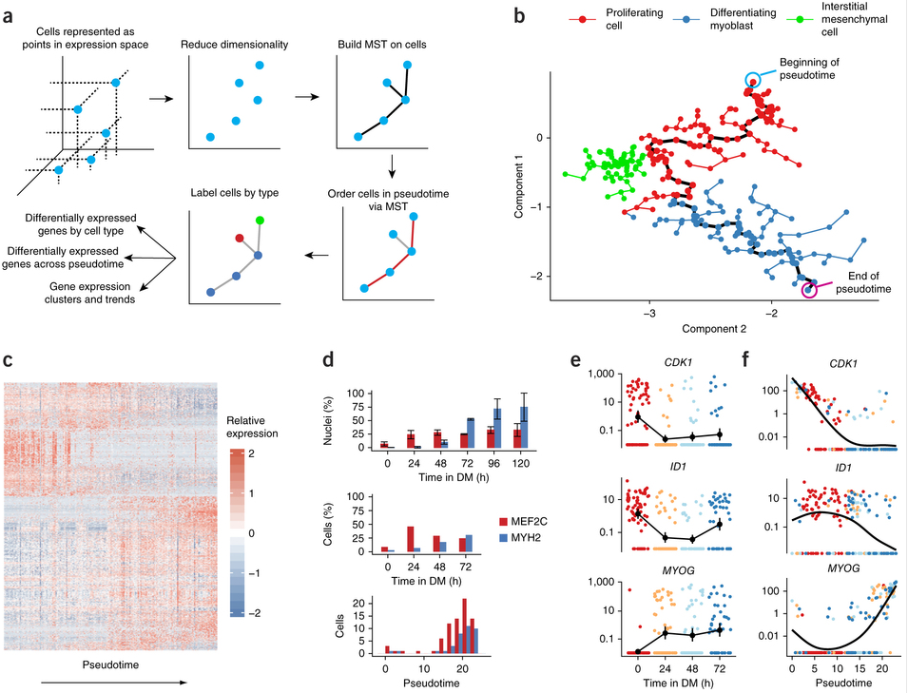
AIM 1 Extended: Monocle
Trapnell, Cole, et al. "The dynamics and regulators of cell fate decisions are revealed by pseudotemporal ordering of single cells." Nature biotechnology 32.4 (2014): 381-386

Slide 26
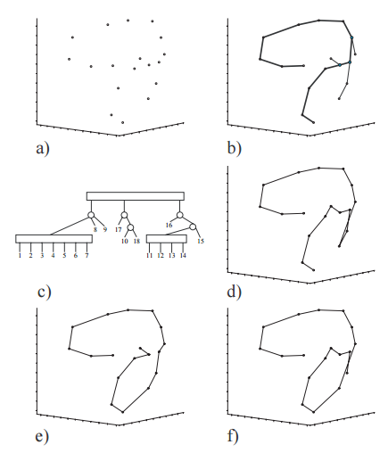
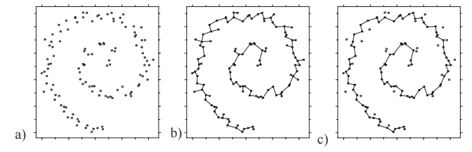
AIM 1 Extended: Monocle P-Q Tree
Magwene, Paul M., Paul Lizardi, and Junhyong Kim. "Reconstructing the temporal ordering of biological samples using microarray data." Bioinformatics 19.7 (2003): 842-850.

Slide 27
AIM 1 Extended: Clustering and ‘Agreement’
Agglomerative hierarchical clustering in ICA space.
Can the MST diameter comment of the order of our clusters?
Use sample ordering output by Monocle, π(i), to order clusters with average cluster index:

Slide 28
AIM 1 Extended: Construct Boolean implication network per cluster
Construct implication network for each cluster
Decouples gene implication from stages in pseudotime/progression.

Slide 29
Datasets & Validation
GSE60749 is an examination of pluripotent stem cells (PSCs) in mus musculus brain tissues. A cluster analysis by Kumar et al. find that there were two clusters. One composed of 98% of the samples and the other only 8% or 14 individual cells. This breakdown may constitute a rare cellular state suitable to evaluate the utility of DREMI-based subsampling techniques.
GSE64016 provides 460 human embryonic stem cells (hESC)—213 H1 single cells and 247 H1-Fucci labeled single cells. With a palatable number of samples, and labeled cycle stage data, this dataset can help evaluate the accuracy of pseudotemporal ordering.
GSE65525 provides ~3000 UMI-barcoded, differentiating, embryonic mouse stem cells from a massively parallelized microfluidics-based single-cell sequencing technology called DropSeq. This dataset may be able to alleviate obstacles that arise from insufficient sample sizes.

Slide 30
Questions?

Slide 31
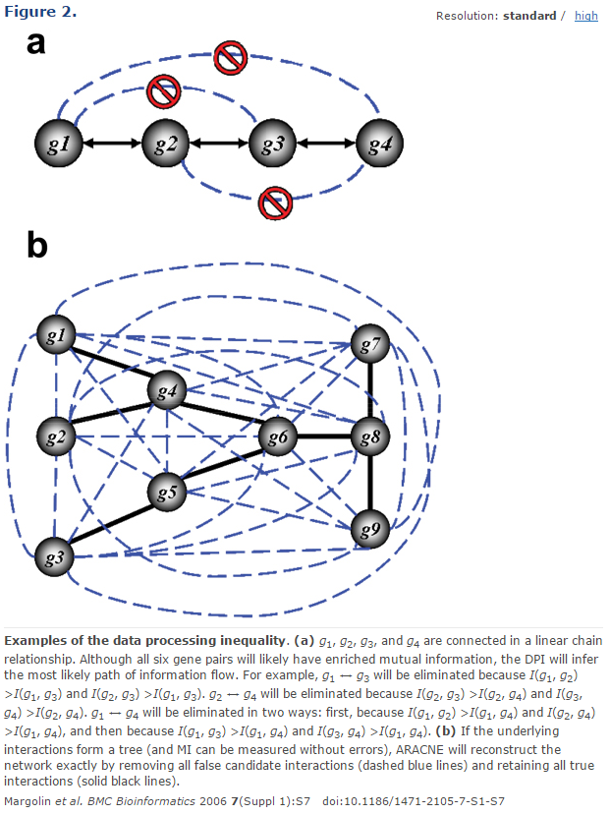
ARACNE
I(g₁,g₃) <= min[I(g₁,g₂), I(g₂,g₃)]

Slide 32
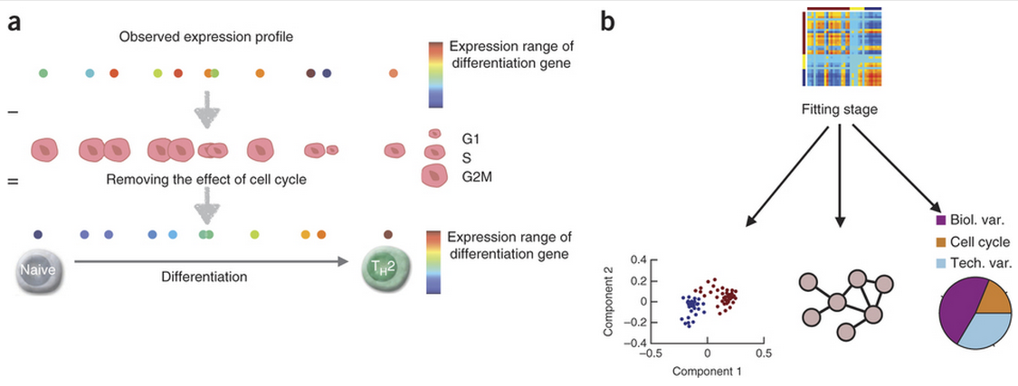
scLVM

Slide 33
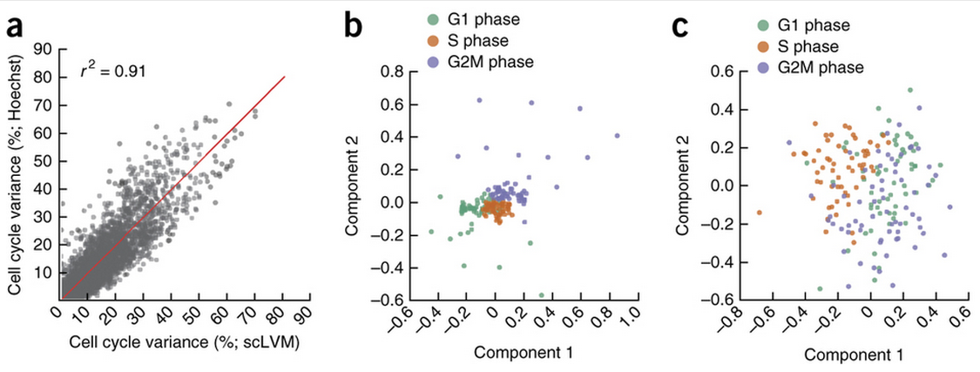
SCLVM

Slide 34
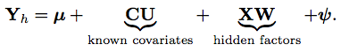
scLVM: Model
C – known covariates
U – weights
X – hidden factors
W – weights
µ – mean
ψ – Gaussian distributed residuals ψ~N(0,v²)

Slide 35
SCDE

Slide 36
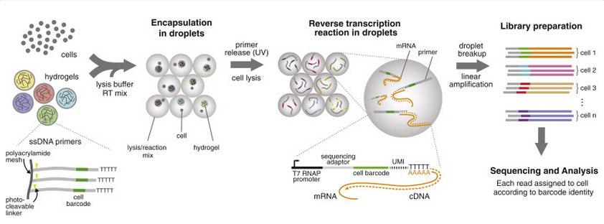
Drop-Seq

Slide 37
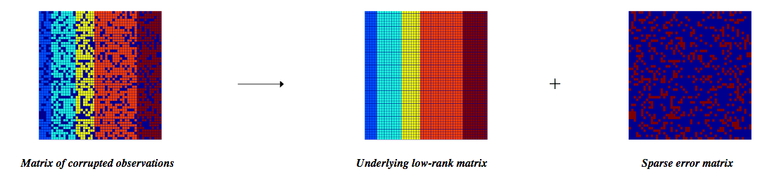
Low Rank Matrix Completion
Write et al. Low-Rank Matrix Recovery and Completion via Convex Optimization

Slide 38
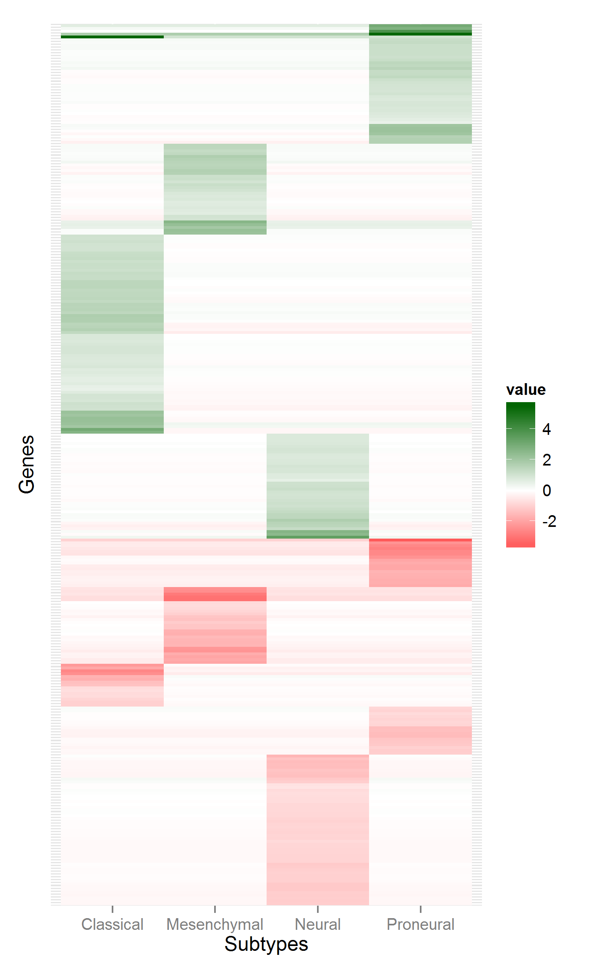
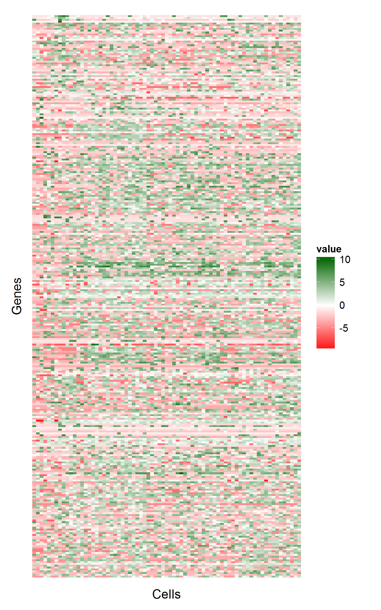
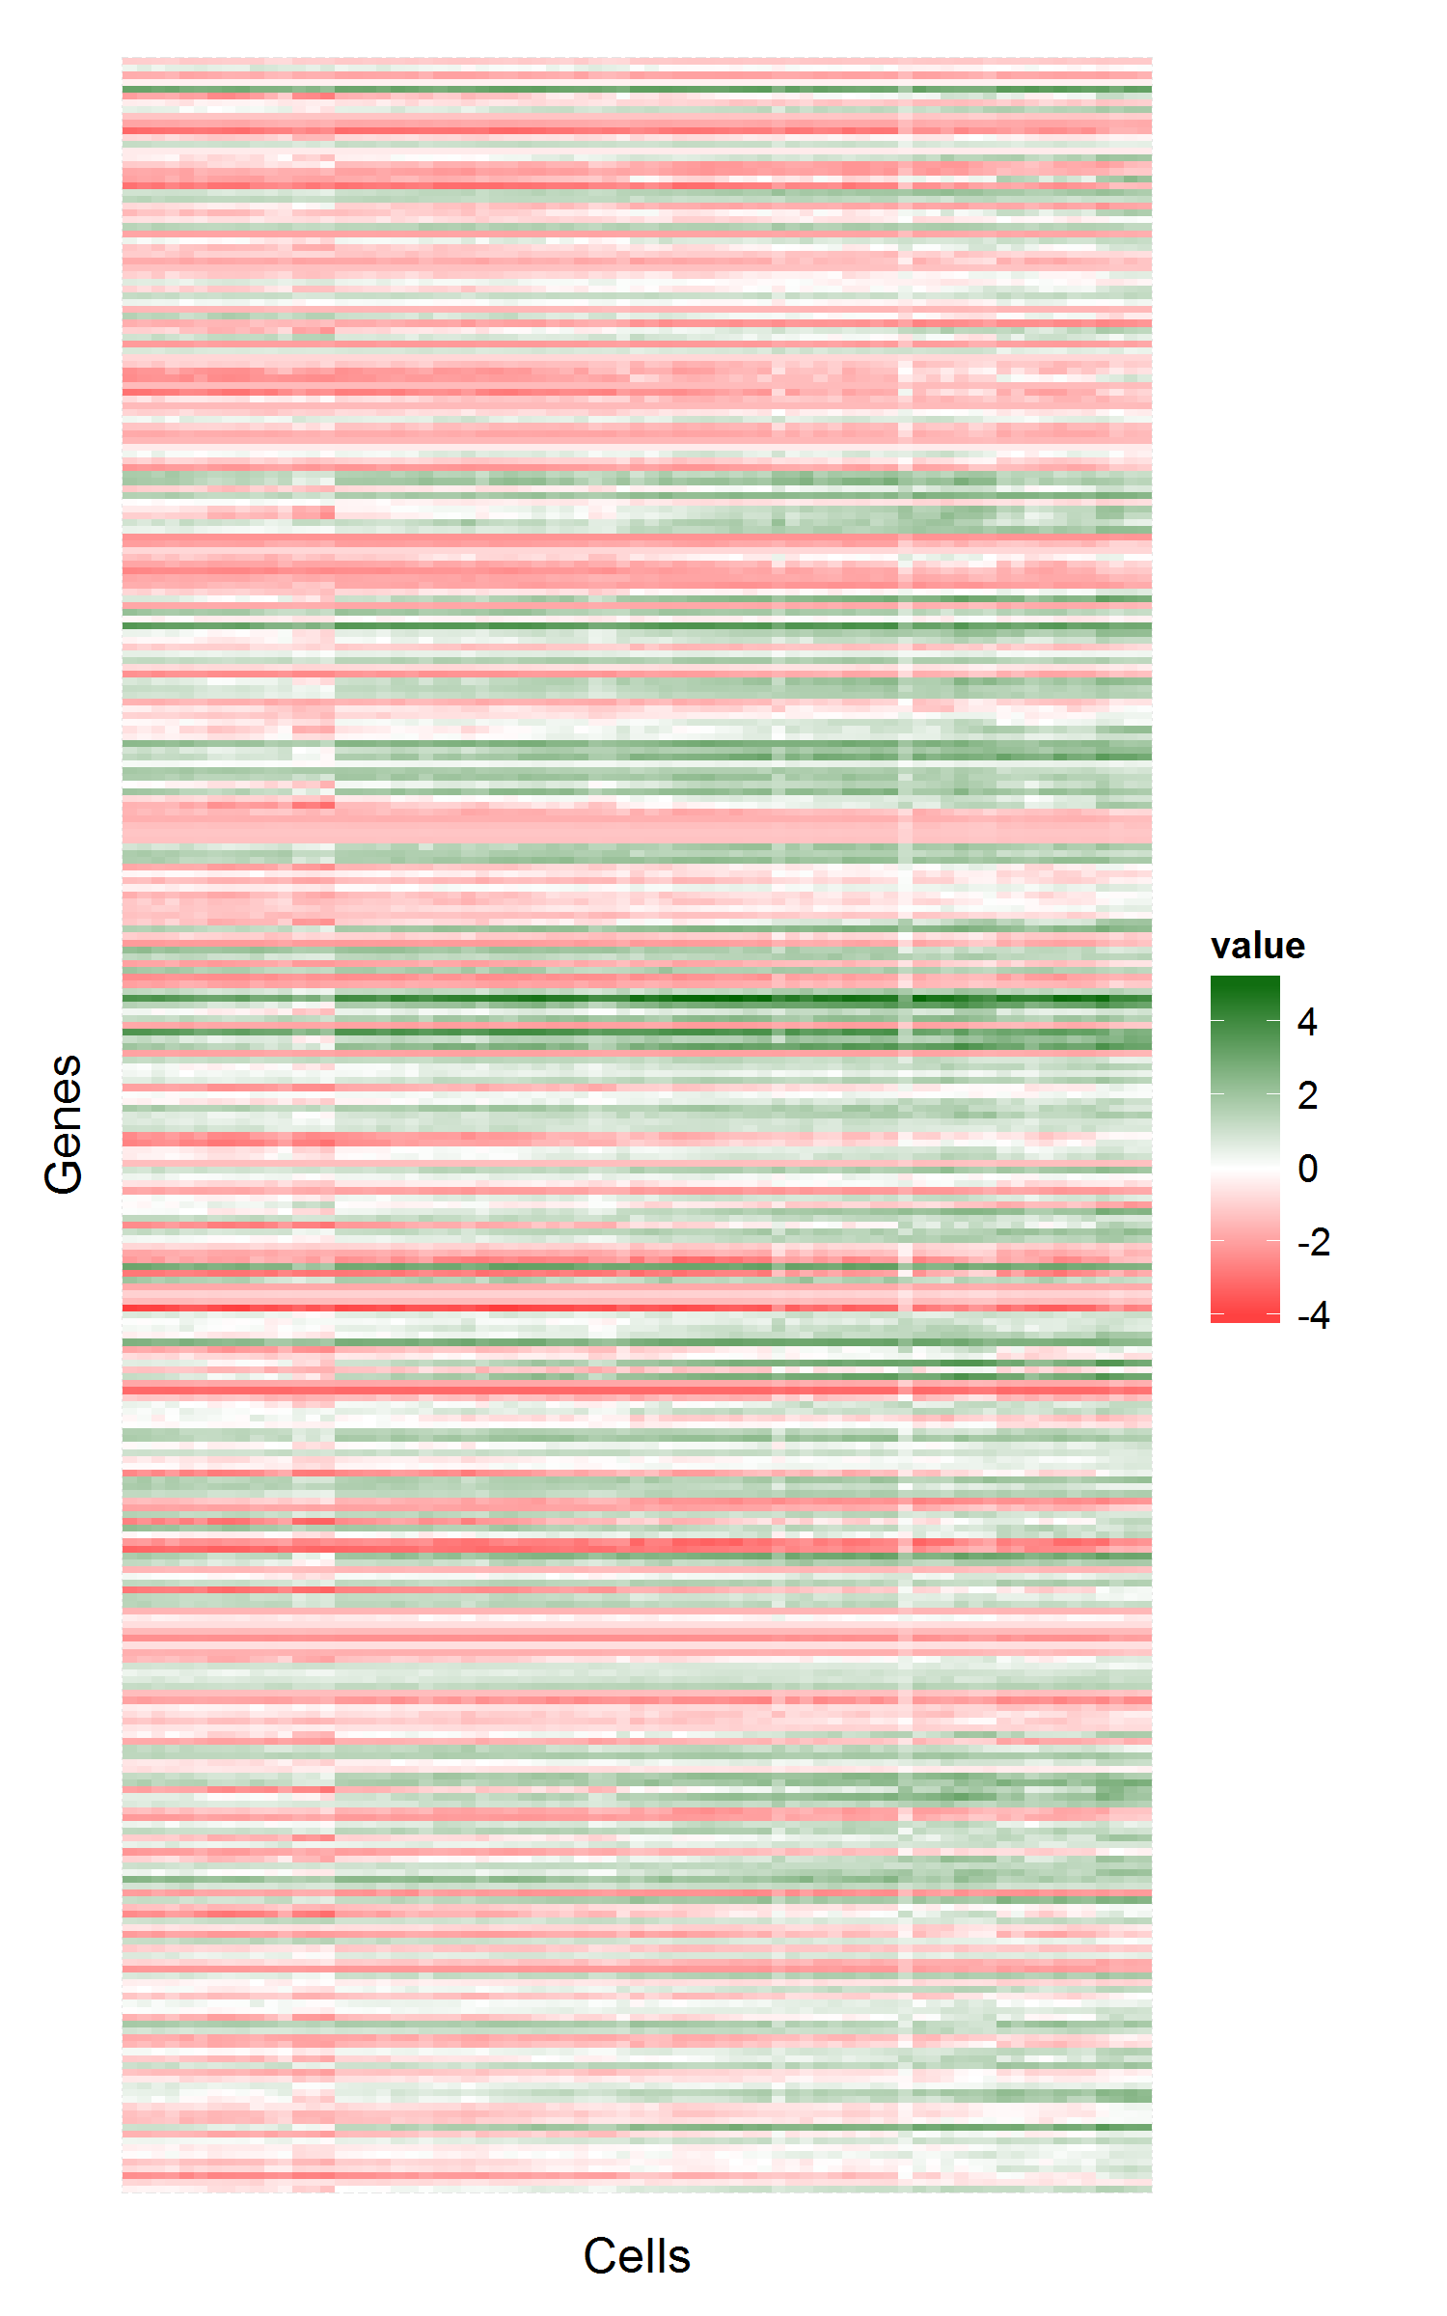
MGH30
Before
After

Slide 39
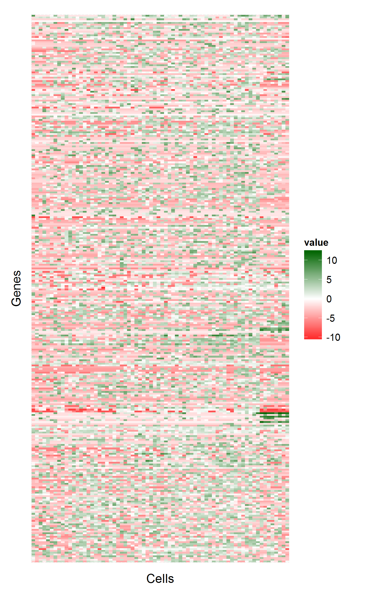
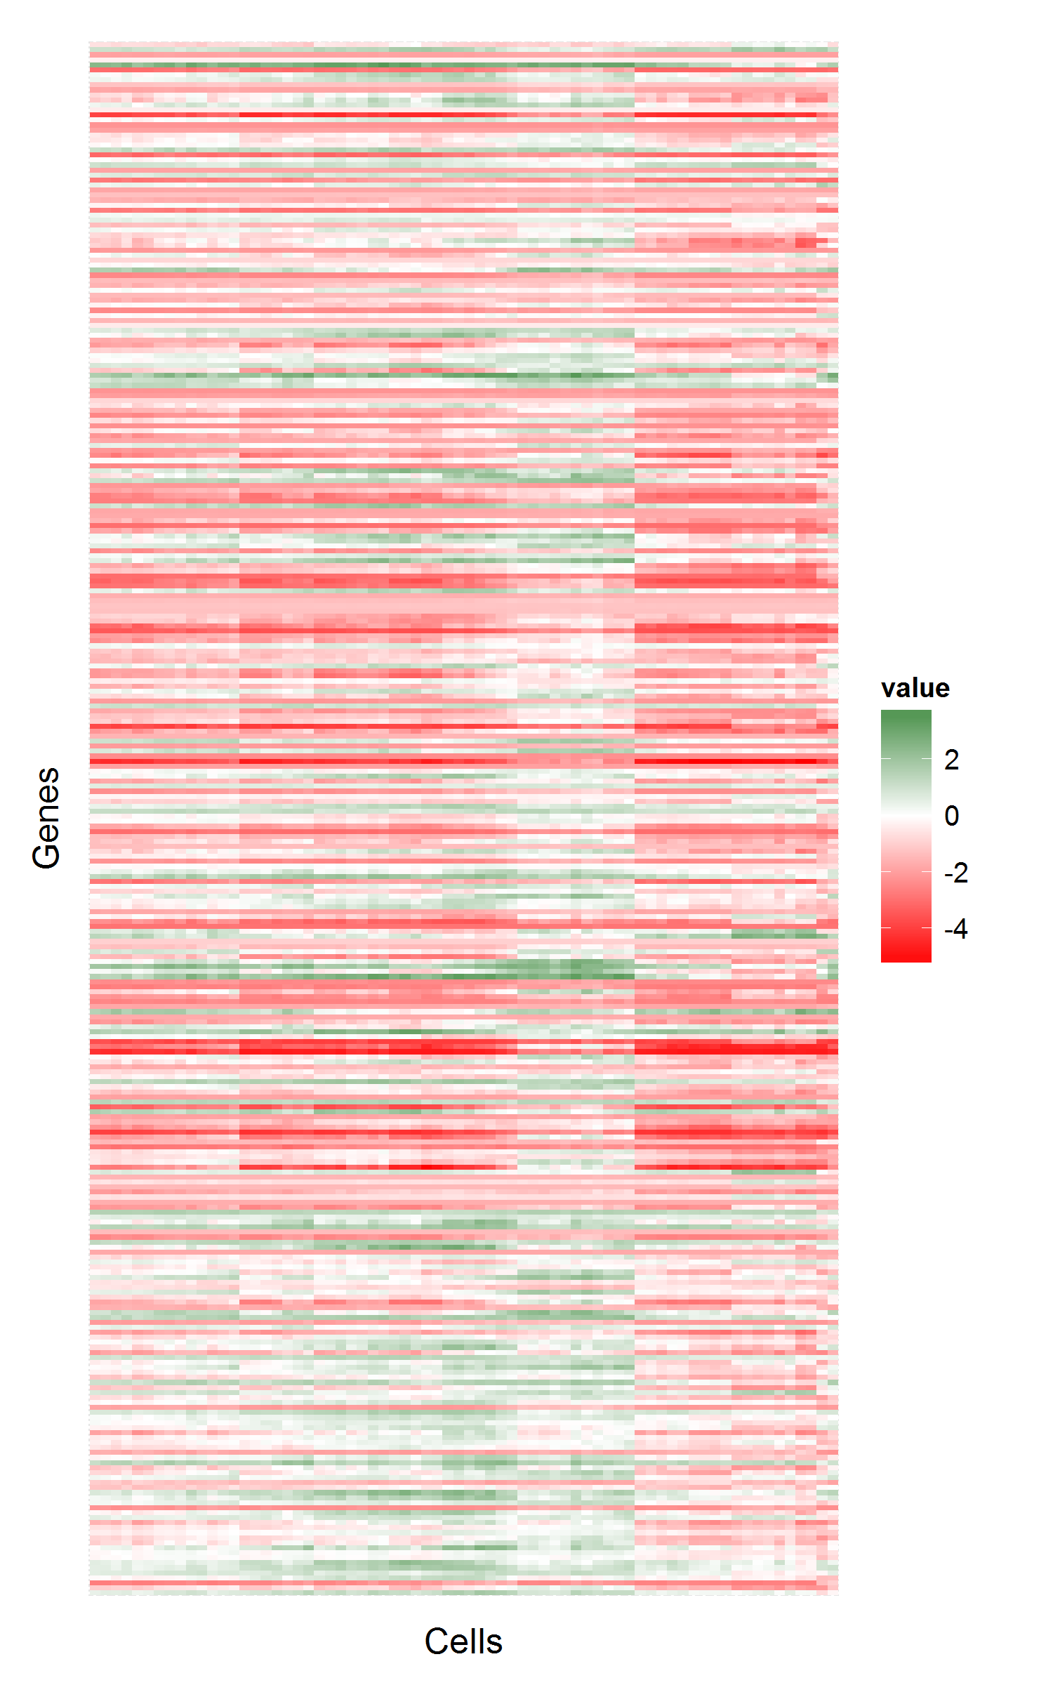
MGH31
Before
After

Slide 40
Not a large change in some values
>> MGH26(1:3,1:3)
ans =
-3.8015 -3.8015 -3.8015
-3.8899 -3.8899 -3.8899
-3.9856 -3.1587 1.7331
>> MGH26p(1:3,1:3)
ans =
-3.8011 -3.8007 -3.8015
-2.0559 -2.3092 -3.9141
-0.5387 -0.6750 0.9668

Slide 41
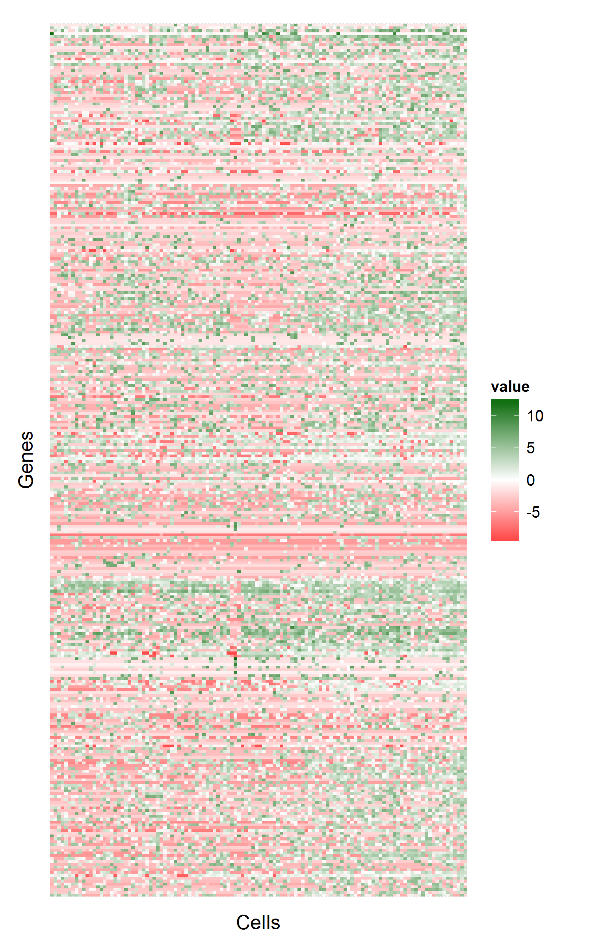
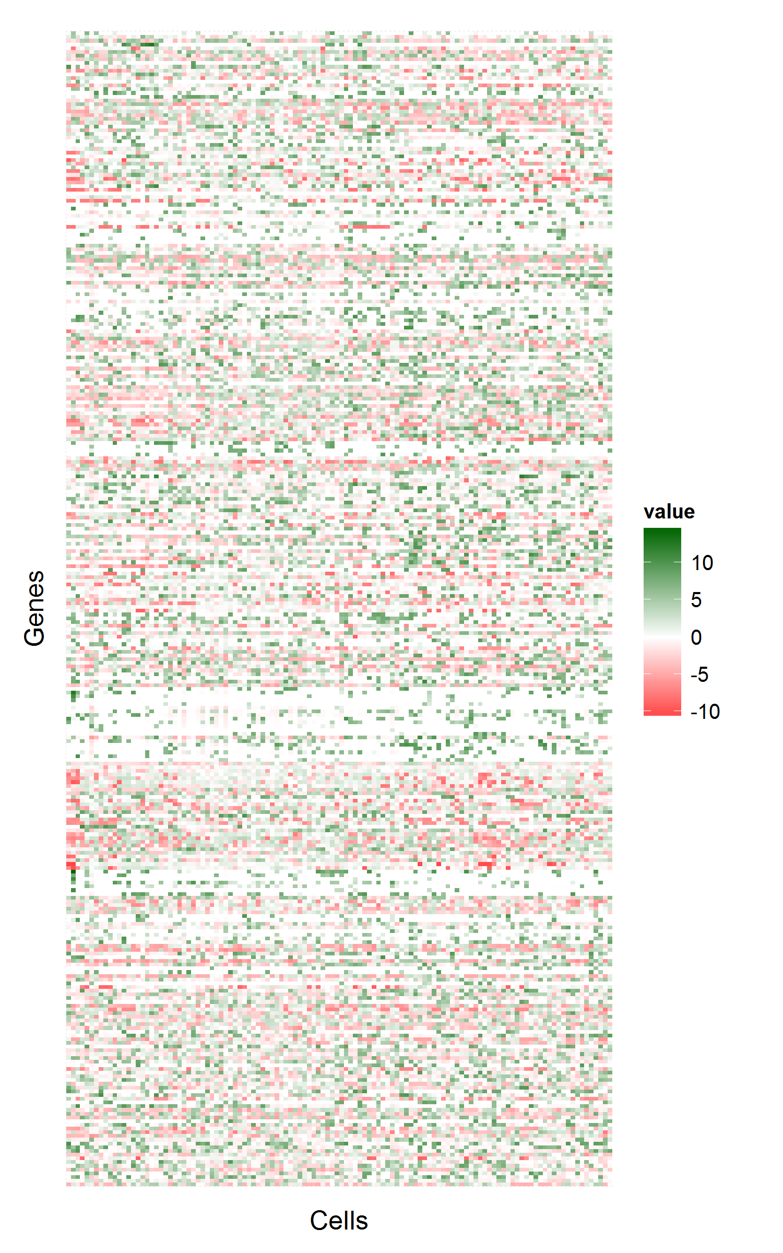

MGH26
Before
After

Slide 42
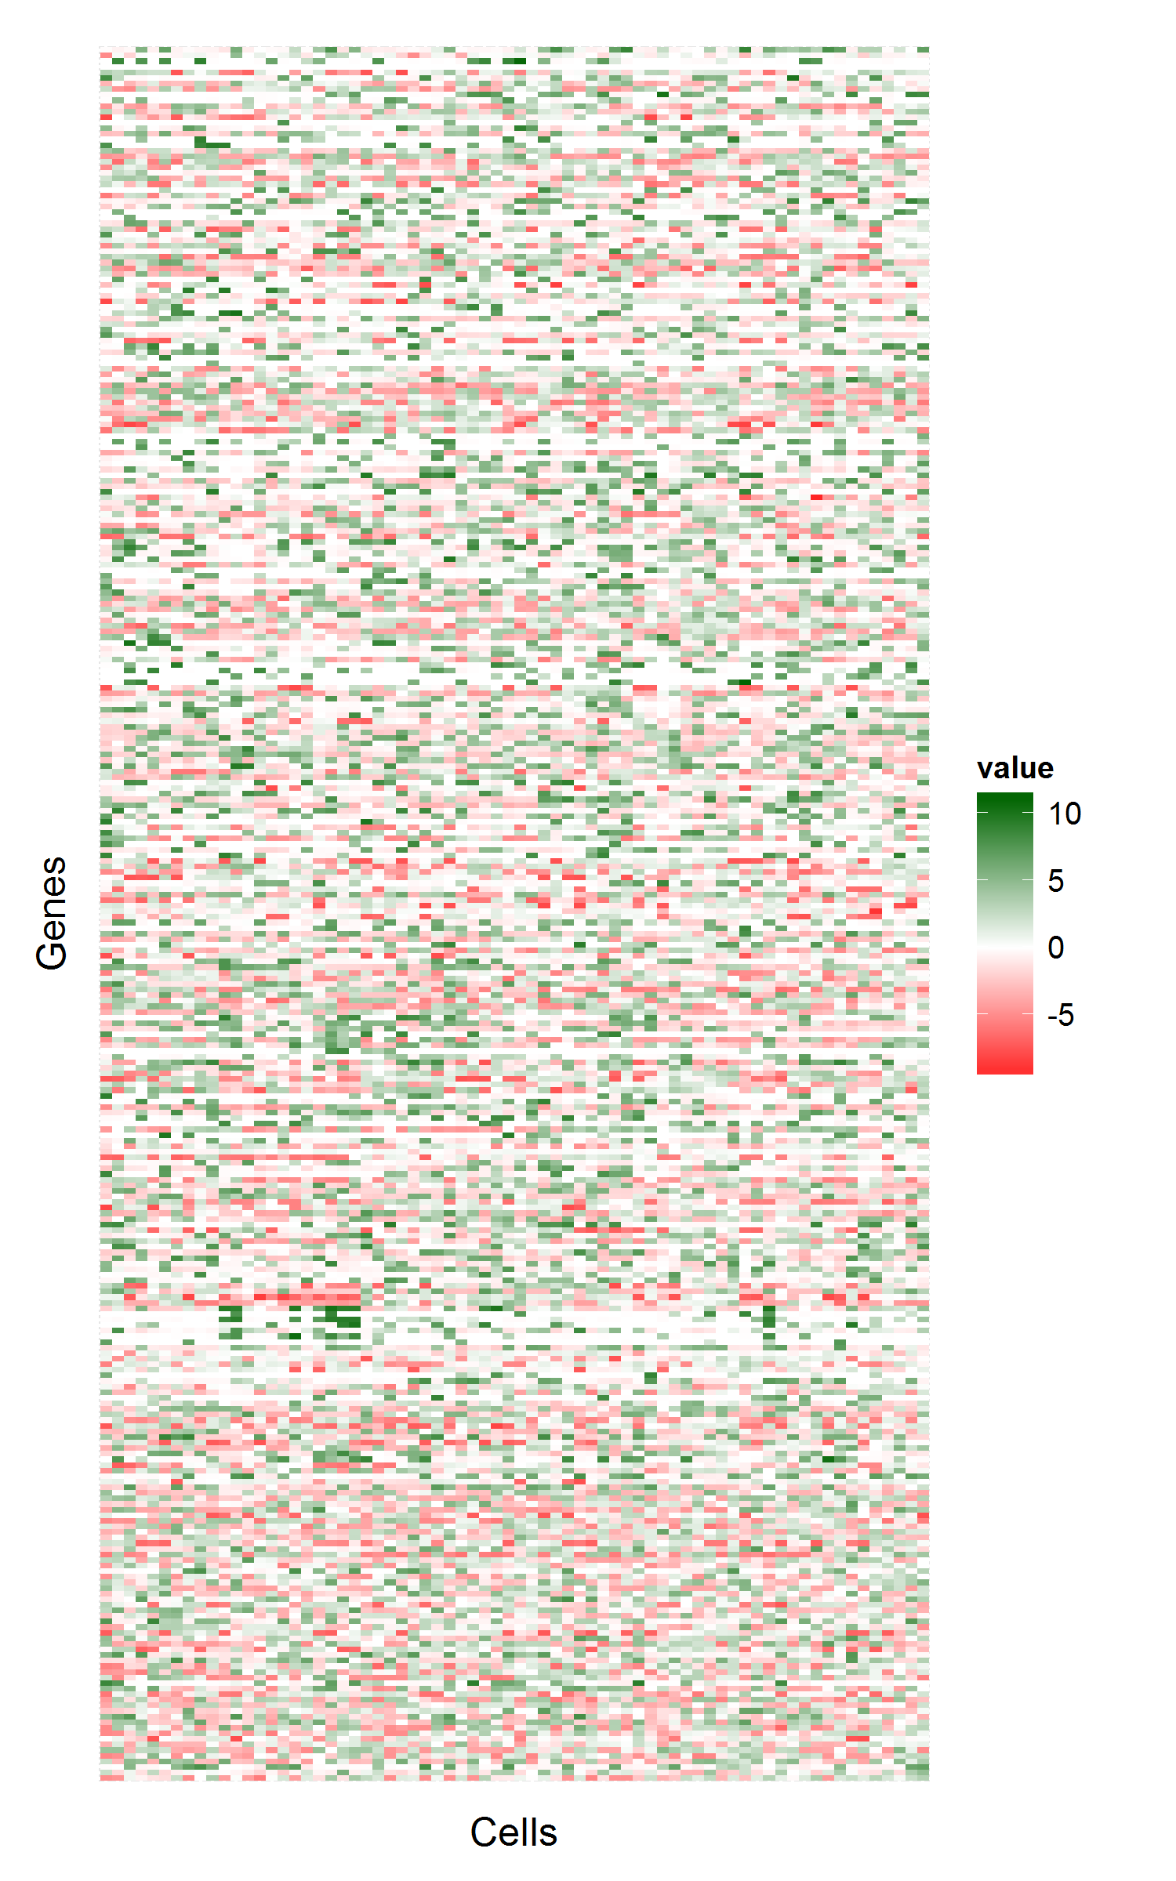
MGH31
Before
After

Slide 44
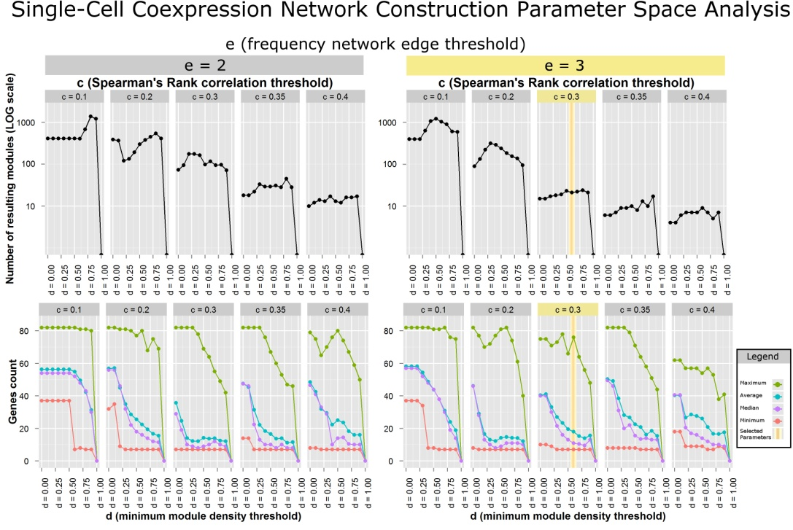

Slide 45
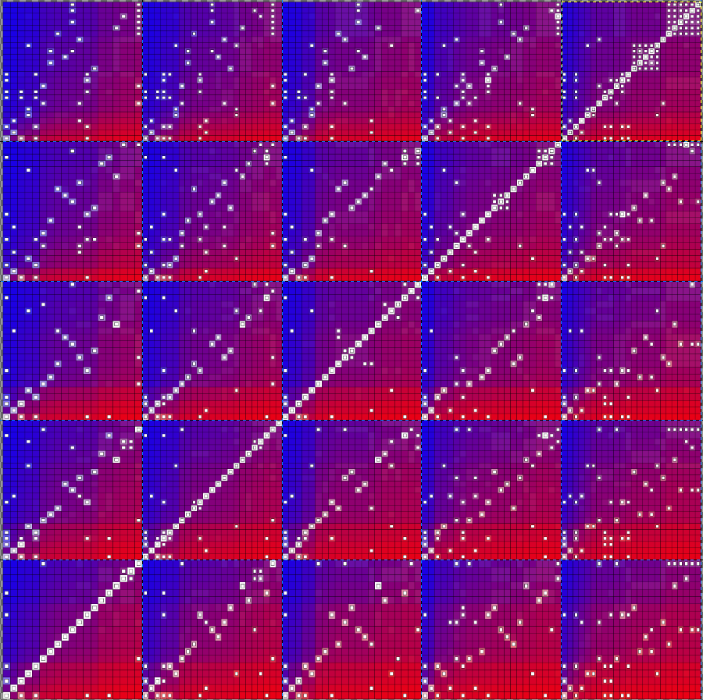
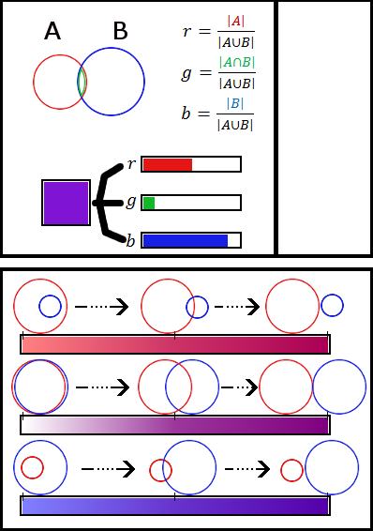
Starry Map
Custom visualization
Encoding
Fisher’s Exact Test
Over encoded

Slide 49
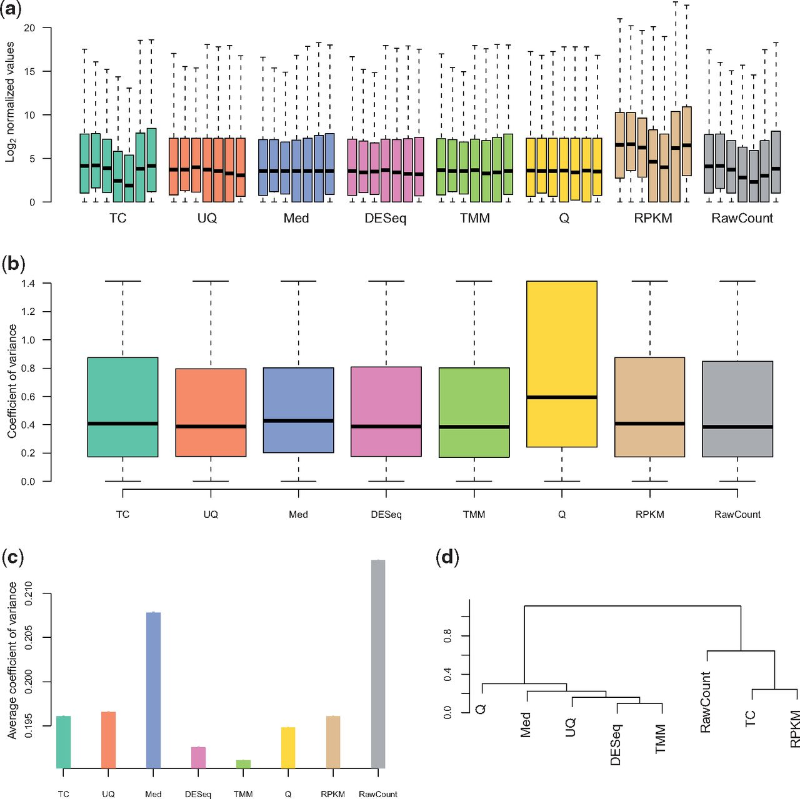
Other Normalizations
Total Count
Upper Quartile
Median
DESeq
Trimmed Mean
of M-values
Quantile
RPKM
RawCount
Dillies M et al. ‘A comprehensive evaluation of normalization methods for Illumina high-throughput RNA sequencing data analysis.’ Brief Bioinform 2012;bib.bbs046
Notes:
TMM is trimmed mean of M-values and is performed on the counts, not on the RPKM. It's a way to control for samples with different populations of RNA by sort of computing a "global fold change" between samples using a trimmed mean as a scaling factor. If your samples are kind of similar to eachother, you might not need it, but if you're worried about different populations of RNAs, TMM normalization might help. Then you would use the TMM normalized read counts to compute differential expresion.

Slide 50
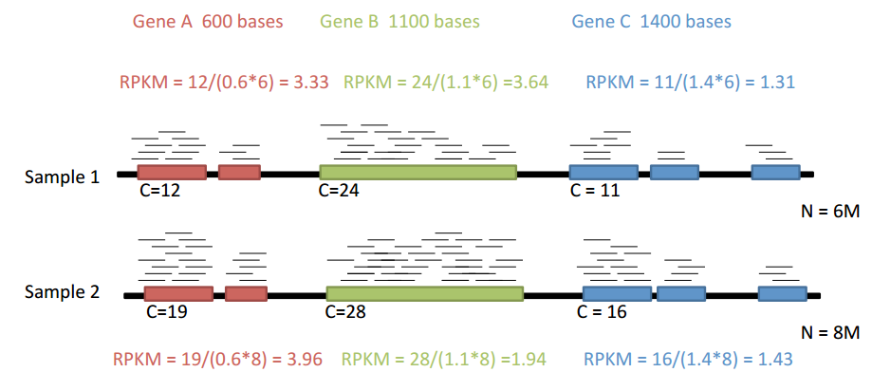
RPKM Example Calculation
Notes:
Recent work suggests that RPKM inadequately accounts for differences in sample library sizes.

Slide 51
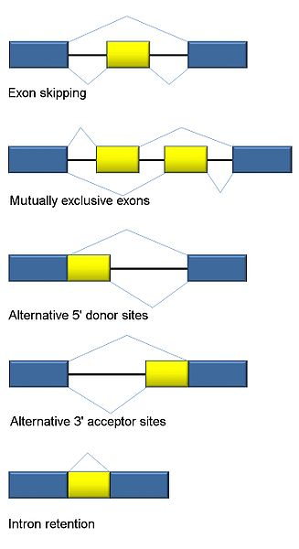
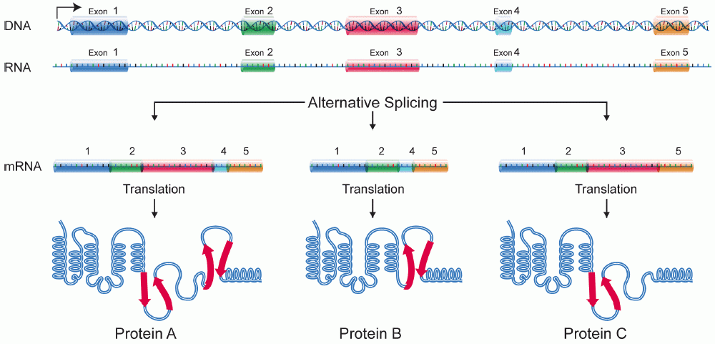
Splice Variants

Slide 52
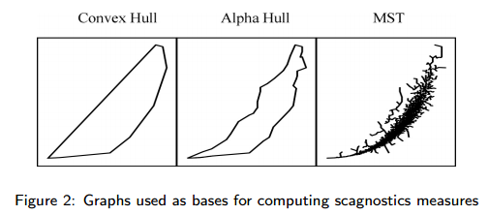
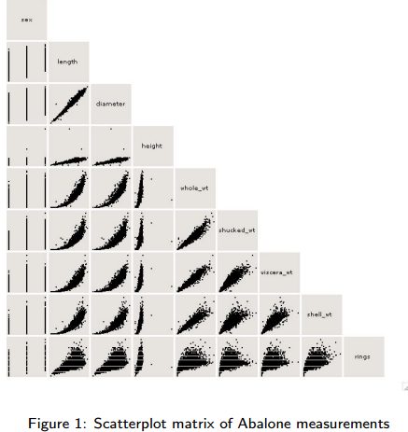
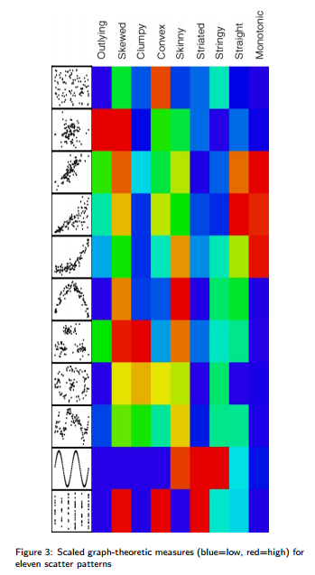
Scagnostics
Wilkinson, Leland, Anushka Anand, and Robert L. Grossman. "Graph-Theoretic Scagnostics." INFOVIS. Vol. 5. 2005.

Slide 53
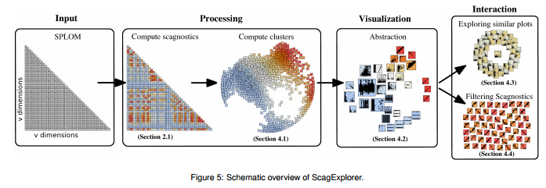
Scagexplorer
Dang, Tuan Nhon, and Lydia Wilkinson. "Scagexplorer: Exploring scatterplots by their scagnostics." Pacific Visualization Symposium (PacificVis), 2014 IEEE. IEEE, 2014.

Slide 54
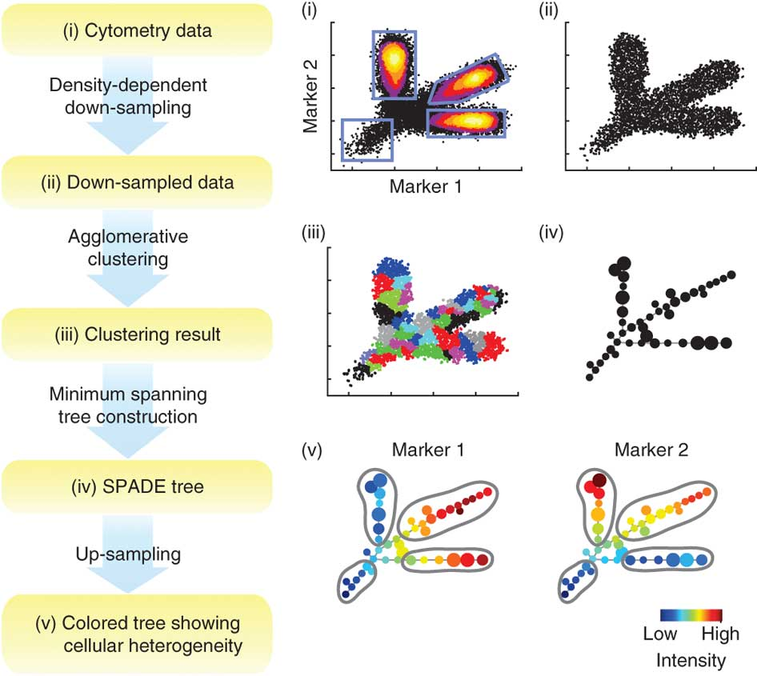
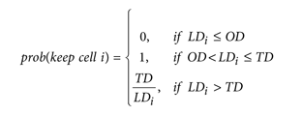
SPADE
Qiu, Peng, et al. "Extracting a cellular hierarchy from high-dimensional cytometry data with SPADE." Nature biotechnology 29.10 (2011): 886-891.

Slide 55
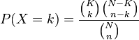
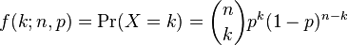
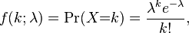
Hypergeometric:
Binomial:
Poisson:
Negative Binomial:

Slide 56
